Slide 1
"Analysis of OTA Booking Data: Key Findings & Strategies"
NAME : KUNDAN KRISHNA
DATE: 7/2/2025
Organization:- TravClan

Slide 2
Introduction & Objectives
This presentation analyzes booking data from an Online Travel Agency (OTA).
The goal is to identify key trends, analyze causes, and suggest strategies to improve sales & profitability.

Slide 3
Key Focus Areas:
Short-term and long-term booking patterns
Impact of pricing and discount strategies
Data-driven recommendations for improvement

Slide 4
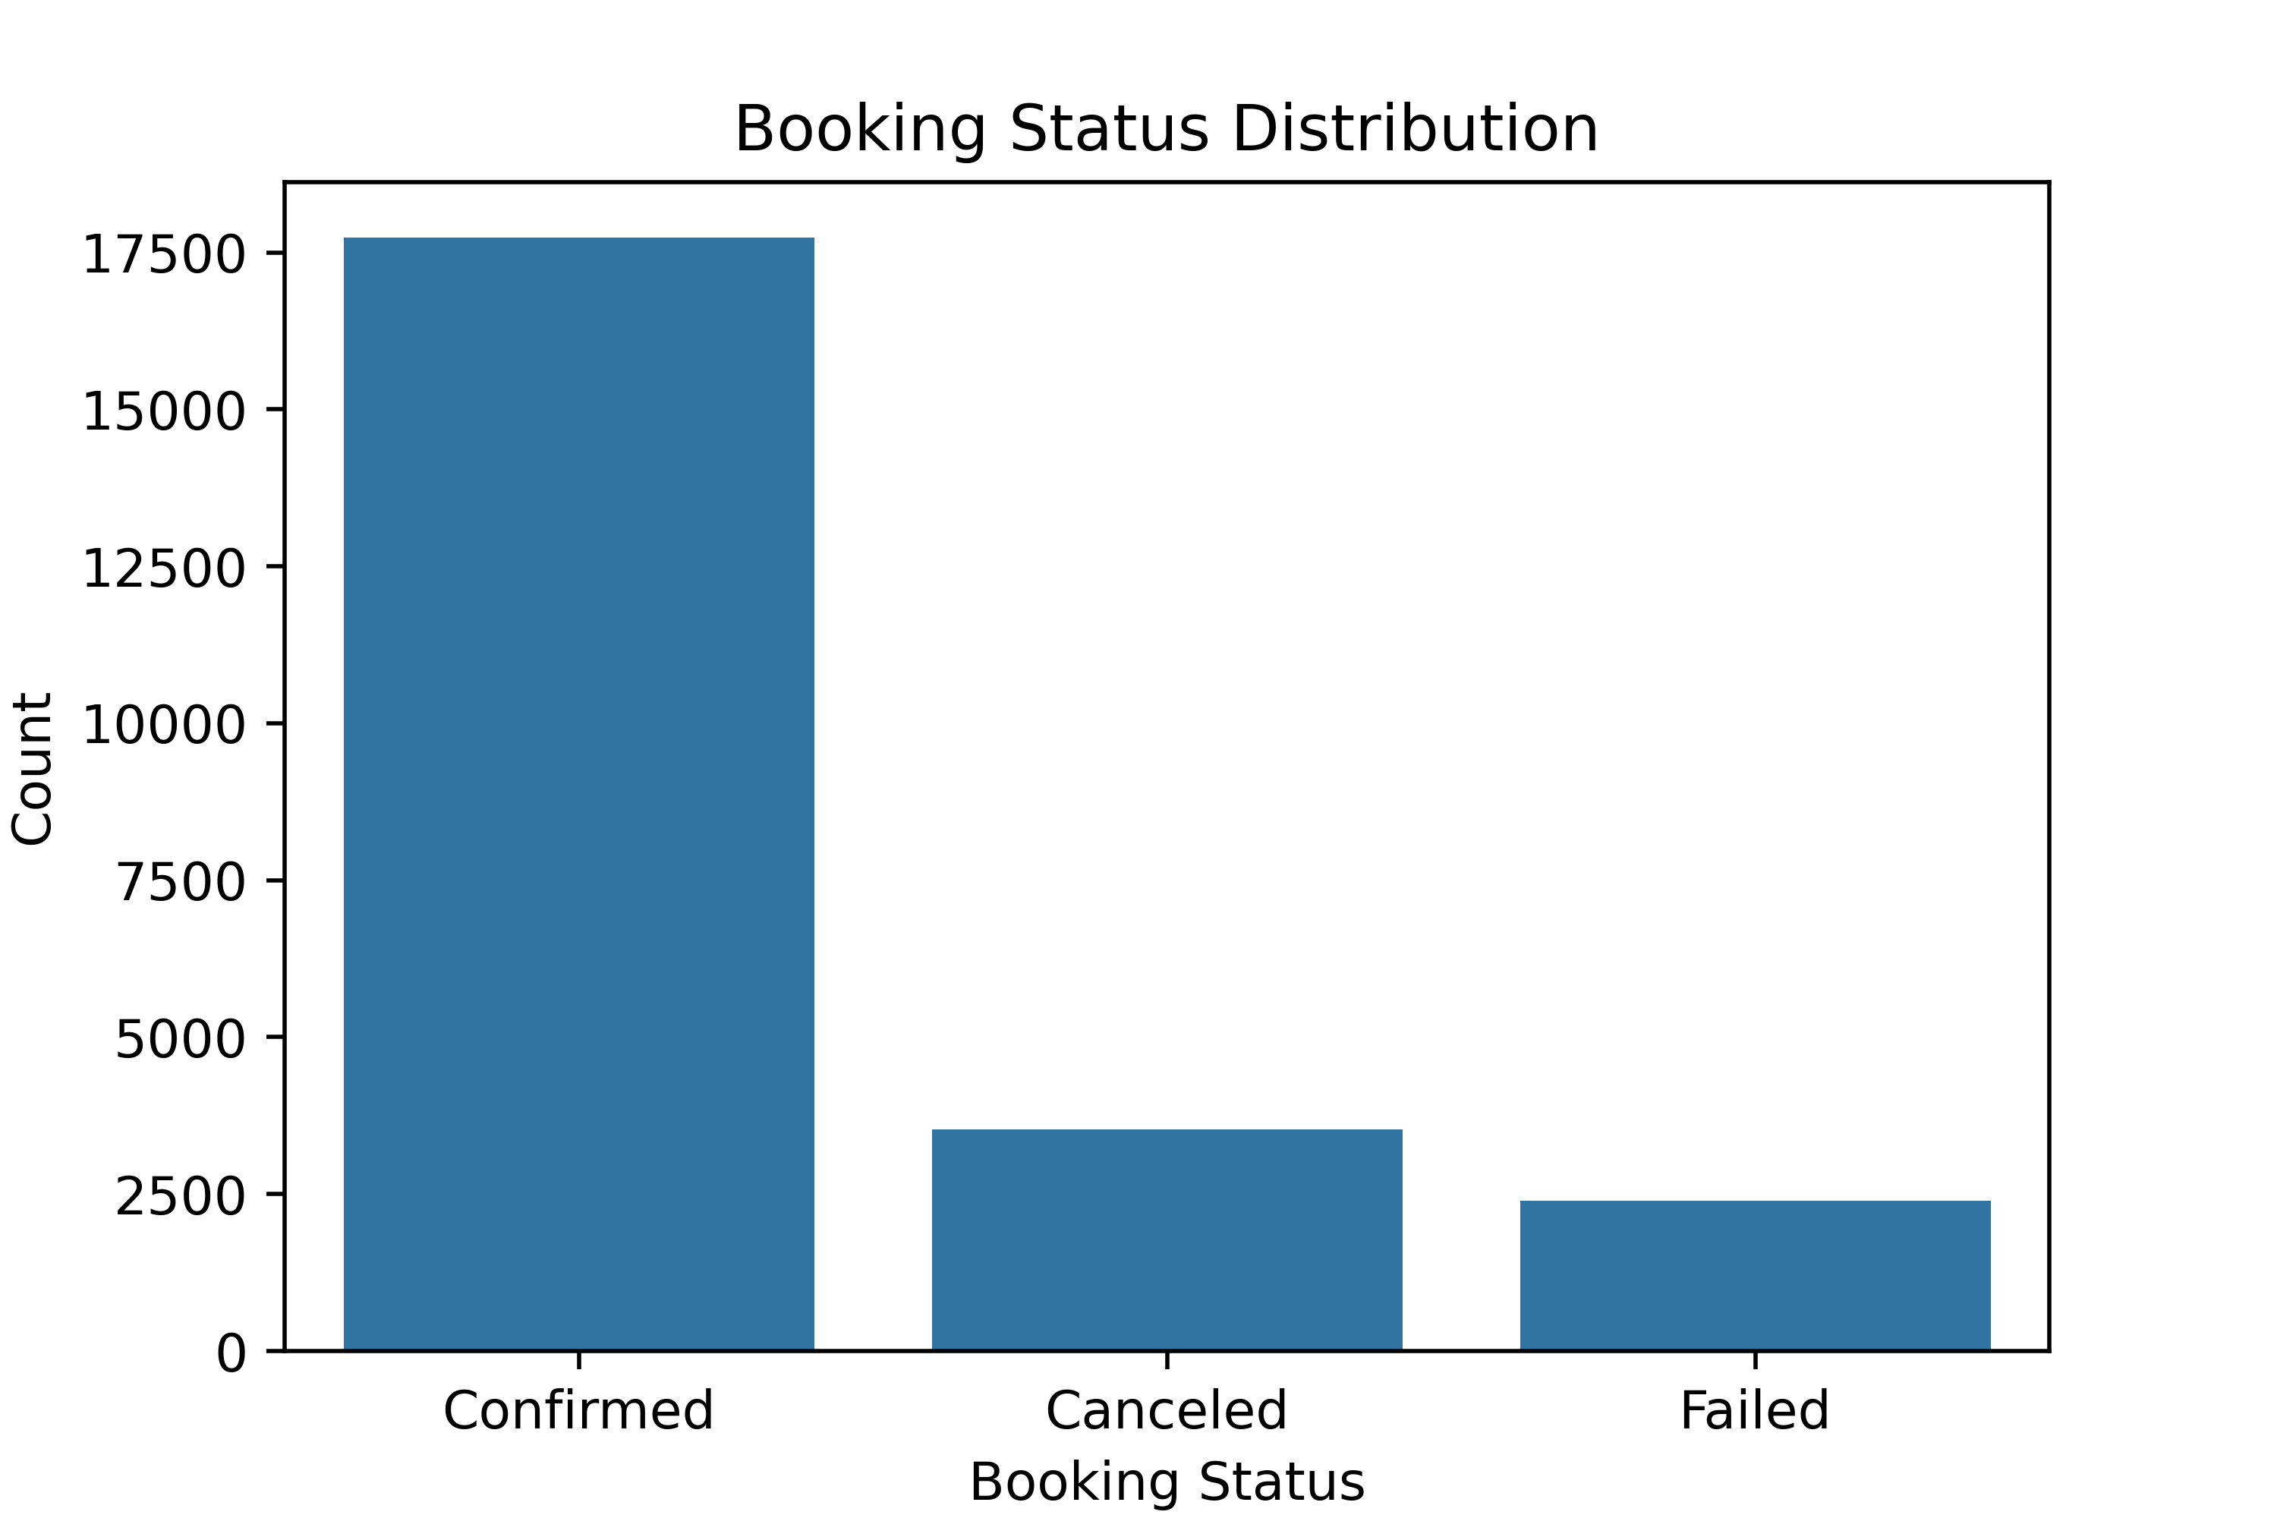
Booking Status Distribution:

Slide 5
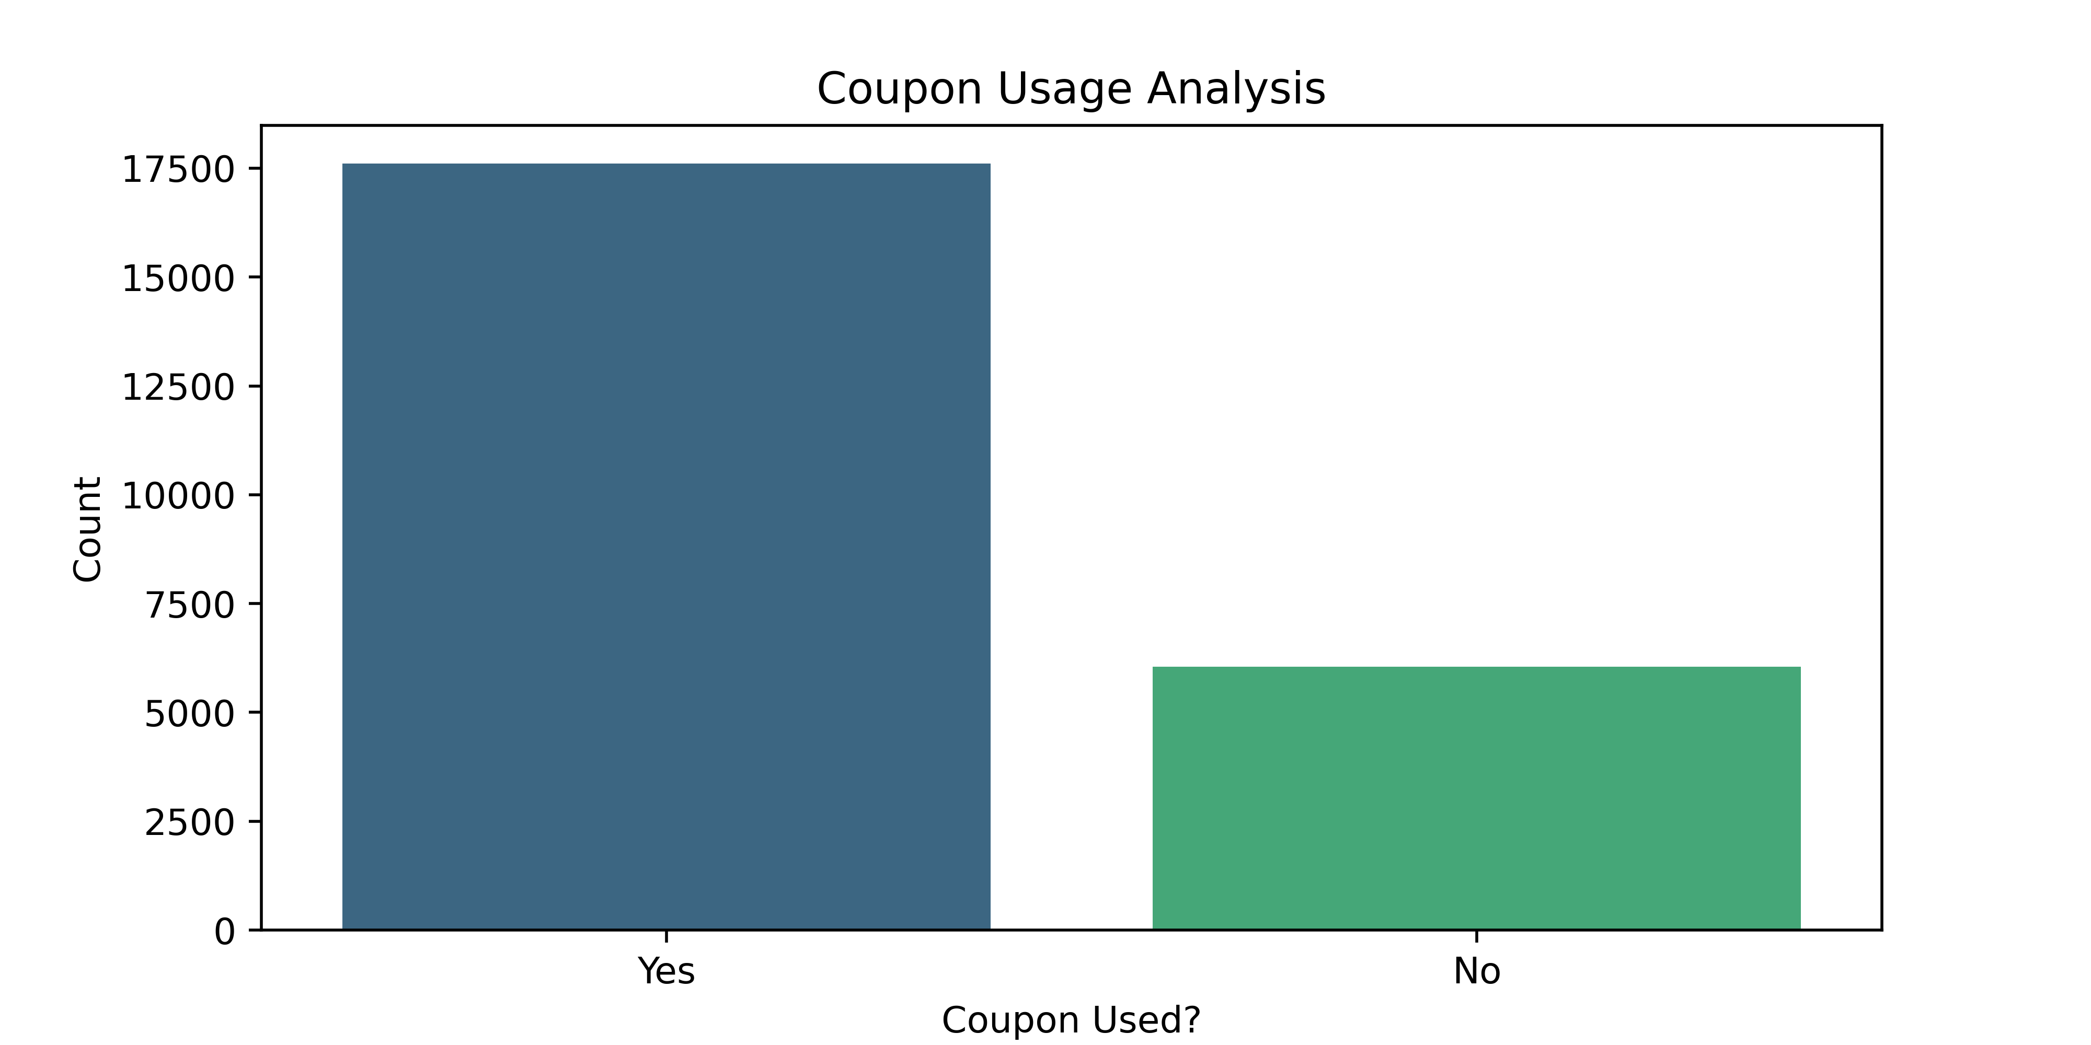
High Coupon Usage Impacting Profits

Slide 6
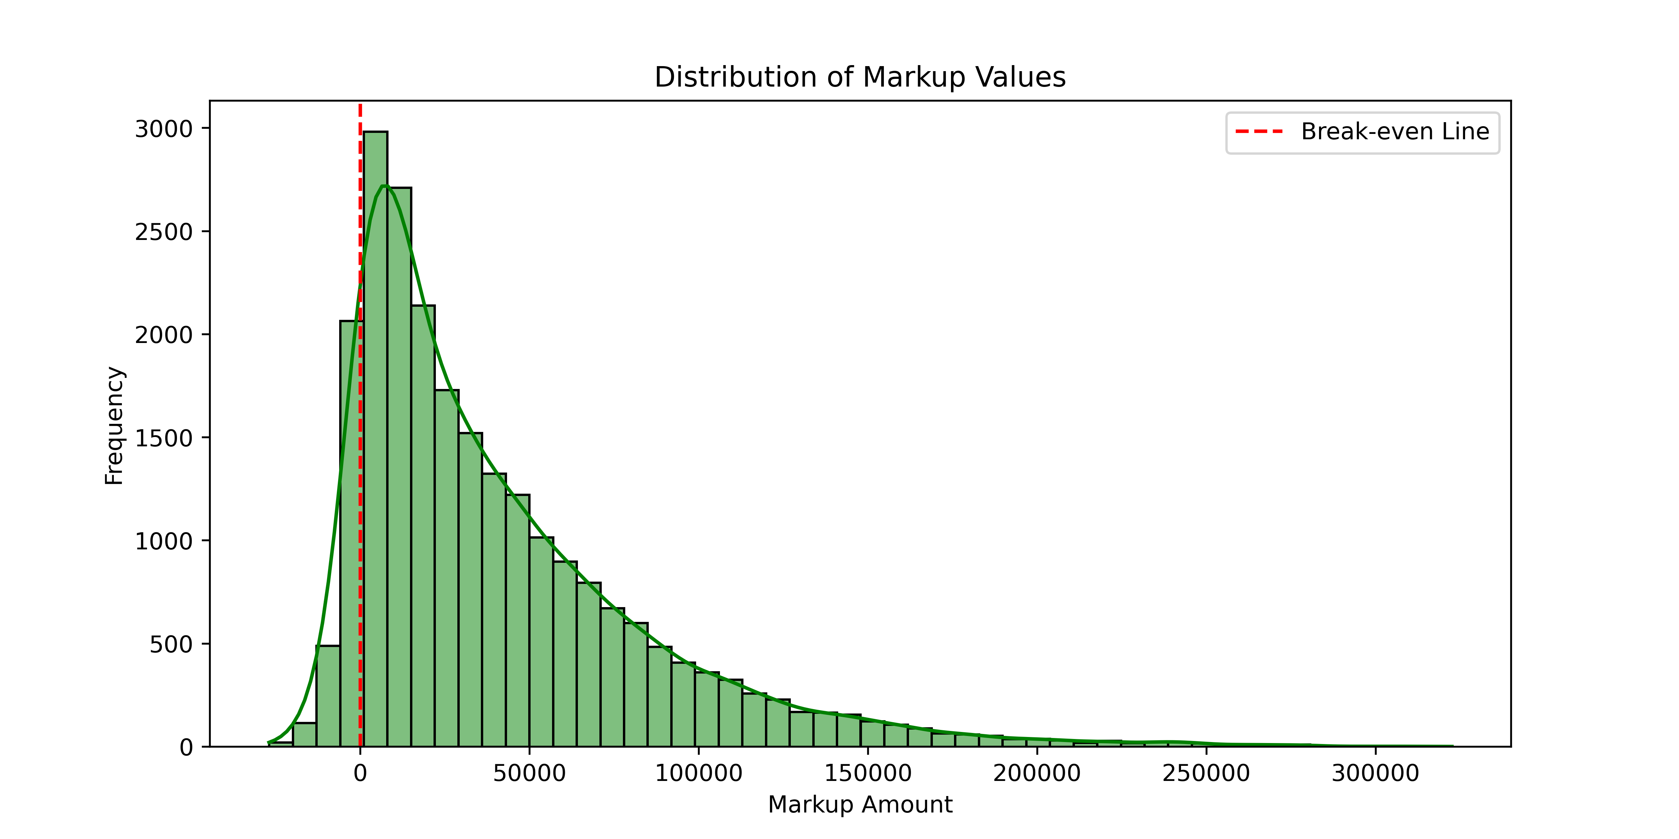
Loss-Making Transactions Due to Negative Markups

Slide 7
Cause Analysis – Why are these trends happening?
Reasons for High Coupon Dependency:
Customers have come to expect discounts → Low willingness to book at full price.
Competitor OTAs might be offering aggressive pricing.
Reasons for Negative Markups:
Lack of pricing rules to prevent loss-making bookings.
Supplier pricing variations not accounted for dynamically.
Reasons for Seasonal Demand:
Certain months have higher travel activity (summer holidays, winter breaks).
(Visual Suggestion): Flowchart showing the root causes.

Slide 8
Strategy 1 – Reduce Loss-Making Transactions
Key Actions: ✔ Implement a Minimum Markup Policy → Set a floor price to prevent selling at a loss. ✔ Monitor Supplier Costs in Real Time → Adjust selling prices based on supplier fluctuations. ✔ Introduce Dynamic Pricing → Increase markup in high-demand periods.

Slide 9
Strategy 2 – Reduce Coupon Dependency & Increase Loyalty
📌 Key Actions: ✔ Shift from blanket discounts to targeted promotions. ✔ Introduce a loyalty rewards program instead of direct discounts. ✔ Bundle services (e.g., Flight + Hotel) to increase perceived value.

Slide 10
Strategy 3 – Capitalizing on Seasonality
📌 Key Actions: ✔ Run seasonal campaigns to drive bookings during slow months. ✔ Offer early-bird discounts for high-demand periods. ✔ Leverage historical data to optimize pricing in peak seasons.

Slide 11
Conclusion – Key Takeaways
✔ High coupon usage is reducing profitability – Shift to loyalty-based promotions. ✔ Negative markup bookings are causing losses – Implement better pricing controls. ✔ Booking seasonality affects sales – Target slow months with special offers.
📊 Next Steps:
Implement data-driven pricing models.
Reduce dependency on generic discounts.
Optimize supplier partnerships for better pricing.

Slide 12
THANK YOU

